Slide 1


CS8811 Project Work Project Title: ANALYSIS OF BOTNET ATTACKS USING MACHINE LEARNING
R.M.K. Engineering College
(An Autonomous Institution)
R.S.M. Nagar, Kavaraipettai-601 206, Gummidipoondi Taluk, Thiruvallur District.
Affiliated to Anna University, Chennai / Approved by AICTE, New Delhi. Accredited by NAAC with A+ Grade / ISO 9001 : 2015 Certified Institution.
All the UG Programs are Accredited by NBA, New Delhi.
Done By:- Team 18
Challa Sai Hari Uma Sahith(111719104032)
Datla Yagnith Varma(111719104037)
Enamala Yashith Reddy(111719104052)
Grandhe Pranav(111719104057)
Project Guide:-
Ms.R.Deepa, M.Tech, Assistant Professor, CSE

Slide 2
DOMAIN INTRODUCTION
IoT is a major technology by which we can produce various useful internet applications.
IoT allows objects to be controlled remotely across existing network infrastructure.
IoT is a very good and intelligent technique which reduces human effort as well as easy access to physical devices.
This technique also has autonomous control feature by which any device can control without any human interaction.

Slide 3
ABSTRACT
Deep Learning (DL) is an efficient method for botnet attack detection.
We reduce the feature dimensionality of large-scale IoT network traffic data using the dimensionality reduction techniques.
Principal Component Analysis (PCA) is one of the common linear transformation methods while kernel methods, spectral methods and DL methods employ non-linear transformation techniques.
Auto encoder is an unsupervised DL method that produces latent-space representation of input data at the hidden layer.
We have to implement the deep learning algorithms such as Long Short-term Memory (LSTM) and Convolutional Neural Network (CNN). Finally, the experimental results shows that the performance metrics such as accuracy, precision, recall and confusion matrix.

Slide 4
OBJECTIVES
The main objective of our project is,
To detect the traffic attack.
To implement the feature dimensionality reduction such as Principle Component Analysis (PCA), for reducing the number of dimensions in the dataset.
To implement the auto encoder for compressing the raw data’s.
To implement the deep learning algorithm such as LSTM and CNN, for better performance.
To enhance the performance analysis.

Slide 5
INTRODUCTION
For the effective feature selection and accurate Bot-IoT attacks identification in IoT network environment a new develop dataset is used.
The dataset includes on the Internet of Things, and normal traffic flows as well as several numerous cyber-attacks traffic flows of botnets attacks.
Nowadays, the Internet of Things (IoT) technology is growing up more day by day, and in every minute, numerous devices are getting connected with this technology.
Botnet is a network of numerous bots designed to perform malicious activities on the target network which are controlled using command and control protocol by the single unit called botmaster.

Slide 6
EXISTING SYSTEM
The system was developed the feature dimensionality reduction.
Then, implement the hybrid deep learning algorithms such LSTM and Auto encoder.
And also used Bidirectional LSTM. Extensive experiments are performed with the BoT-IoT dataset to validate the effectiveness of the proposed hybrid DL method.
Results show that LAE significantly reduced the memory space required for large-scale network traffic data storage by 91.89%, and it outperformed state-of-the-art feature dimensionality reduction methods by 18.92−27.03%
Reference: Segun I. Popoola, Bamidele Adebisi, Mohammad Hammoudeh, Guan Gui, Haris Gacanin, “Hybrid Deep Learning for Botnet Attack Detection in the Internet of Things Networks”, DOI-10.1109, IEEE Internet of Things Journal,2020.

Slide 7
DISADVANTAGES
The results is low when compared with proposed
It doesn’t efficient for large volume of data’s
Theoretical limits.

Slide 8
PROPOSED SYSTEM
In this system, the Bot-Iot dataset was taken as input from the dataset repository.
Then, we have to implement the data preprocessing step.In this step, we have to handle the missing values for avoid wrong prediction, to encode the label for input data and normalize/ scaling the input data.
Then, we have to implement the feature dimensionality reduction such as Principal Component Analysis (PCA).
We have to implement the deep learning algorithms such as Long Short term Memory (LSTM) and Convolutional Neural Network (CNN).
Finally, the experimental results shows that the performance metrics such as accuracy, precision, recall and confusion matrix.

Slide 9
ADVANTAGES
It is efficient for large number of datasets.
The experimental result is high when compared with existing system.
In addition, to implement the CNN for better performance.

Slide 10
SYSTEM ARCHITECTURE
Data set( Bot-IOT )
Input data
Handle missing value
Preprocessing
Label Encoding
Normalize/scalar
Encoder
Dimensionality Reduction
Decoder
PCA
Auto encoder
CNN
Classification
LSTM

Slide 11
FLOW DIAGRAM
Start
Input Data
Preprocessing
Dimensionality reduction
Auto encoder
Classification

Slide 12
MODULES
Data selection
Data preprocessing
Data normalization
Dimensionality reduction
Auto encoder
Classification
Result Generation

Slide 13
MODULES DESCRIPTION

Slide 14
DATA SELECTION
The input data was collected from dataset repository.
In our process, the Bot-IoT dataset is used.
The data selection is the process of detecting the malicious traffic.
The dataset includes on the Internet of Things, and normal traffic flows as well as several numerous cyber-attacks traffic flows of botnets attacks.
However, for better performance results, the extracted features are labelled, such as attack flow, categories, and subcategories.

Slide 15
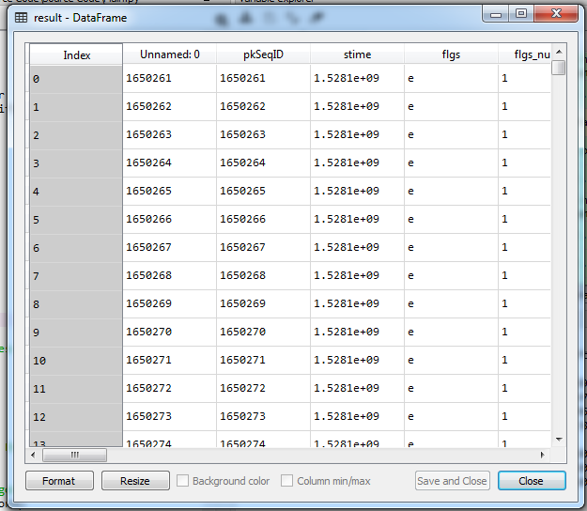
DATA SELECTION

Slide 16
PRE-PROCESSING
Data pre-processing is the process of removing the unwanted data from the dataset.
Pre-processing data transformation operations are used to transform the dataset into a structure suitable for machine learning.
Missing data removal: In this process, the null values such as missing values and Nan values are replaced by 0.
Encoding Categorical data: That categorical data is defined as variables with a finite set of label values.

Slide 17
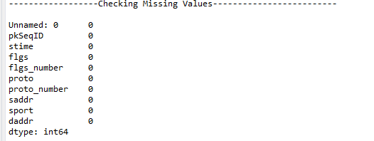
Data preprocessing –Handling Missing values

Slide 18
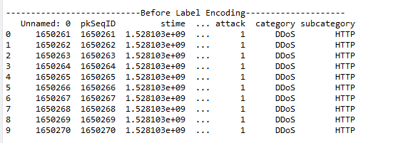
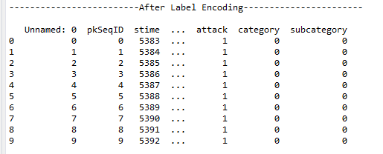
Label Encoding

Slide 19
DATA NORMALIZATION
Normalization scales each input variable separately to the range 0-1, which is the range for floating-point values where we have the most precision.
Standardization scales each input variable separately by subtracting the mean (called centering) and dividing by the standard deviation to shift the distribution to have a mean of zero and a standard deviation of one.

Slide 20
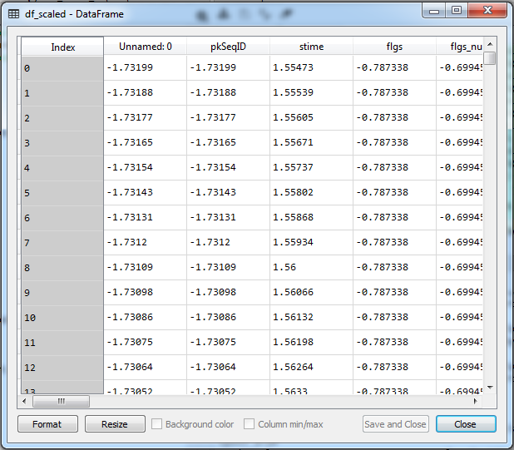
DATA NORMALIZATION

Slide 21
DIMENSIONALITY REDUCTION
Dimensionality reduction technique can be defined as, it is a way of converting the higher dimensions dataset into lesser dimensions dataset ensuring that it provides similar information.
In this step, we have to use PCA (principle component analysis).
PCA is used for visualization, noise filtering, and feature extraction

Slide 22
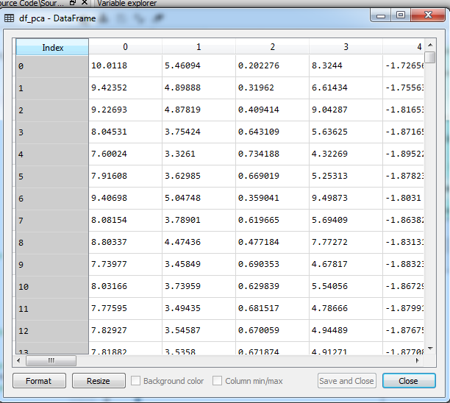
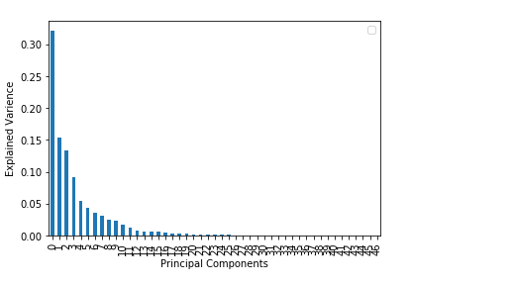
PCA

Slide 23
AUTOENCODER
Auto encoder is a type of neural network that can be used to learn a compressed representation of raw data.
An auto encoder is composed of an encoder and a decoder sub-models.
The encoder compresses the input and the decoder attempts to recreate the input from the compressed version provided by the encoder.
After training, the encoder model is saved and the decoder is discarded.

Slide 24
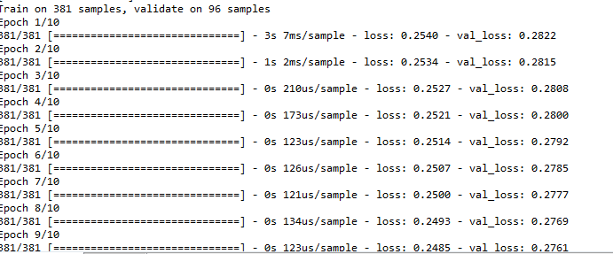
AUTOENCODER

Slide 25
CLASSIFICATION
LSTM Long short-term memory is an artificial recurrent neural network architecture used in the field of deep learning.
Unlike standard feed forward neural networks, LSTM has feedback connections.
A Convolutional Neural Network (ConvNet/CNN) is a Deep Learning algorithm which can take in an input image, assign importance (learnable weights and biases) to various aspects/objects in the image and be able to differentiate one from the other.

Slide 26
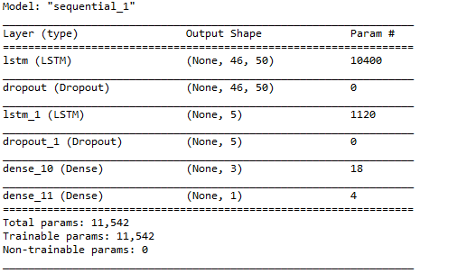
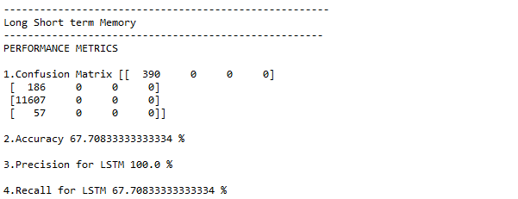
LSTM

Slide 27
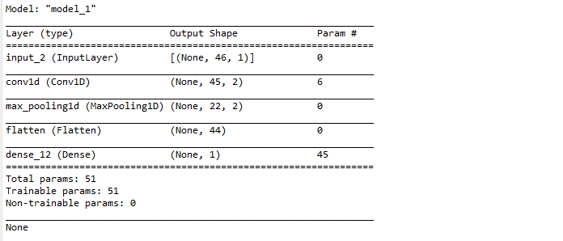
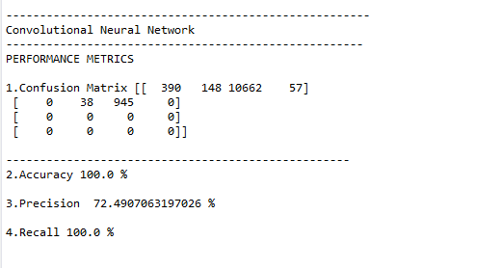
CNN
CNN

Slide 28
PERFORMANCE ANALYSIS
The Final Result will get generated based on the overall classification and prediction. The performance of this proposed approach is evaluated using some measures like,
Accuracy
Precision
Recall
F1-score

Slide 29
LITERATURE SURVEY
Title | Year | Author | Methodology | Merits/demerits
Internet of Things Cyber Attacks Detection using Machine Learning | 2019 | Jadel Alsamiri1, Khalid Alsubh | In this study, we aim to contribute to the literature by evaluating various machine learning algorithms that can be used to quickly and effectively detect IoT network attacks. A new dataset, Bot-IoT, is used to evaluate various detection algorithms. In the implementation, seven different machine learning algorithms were used. | One of the advantages of this class of detection technique is its ability to detect all known attacks effectively without generating an overwhelming number of false alarms.

Slide 30
LITERATURE SURVEY
Title | Year | Author | Methodology | Merits/demerits
Towards Effective Detection of Botnet A e Detection of Botnet Attacks using BoT ttacks using BoT-IoT Dataset | 2020 | Dr Ali Raza | The study is implemented on the BoT-IoT dataset using three supervised ML classifiers: K-nearest Neighbor, Random Forest, and Logistic Regression. | KNN algorithm is nonparametric as it does not form an assumption about the data which can be advantageous in the case of real-world data.

Slide 31
LITERATURE SURVEY
Title | Year | Author | Methodology | Merits/demerits
IoT Security: Botnet detection in IoT using Machine learning | 2020 | Satish Pokhrel, Robert Abbas, Bhulok Aryal | Our proposed model tackles the security issue concerning the threats from bots. Different machine learning algorithms such as K- Nearest Neighbour (KNN), Naive Bayes model and Multi-layer Perception Artificial Neural Network (MLP ANN) were used to develop a model where data are trained by BoT-IoT dataset. | The advantage of this approach is the ability to detect new malware family used in botnet attack

Slide 32
LITERATURE SURVEY
Title | Year | Author | Methodology | Merits/demerits
A Framework for Malicious Traffic Detection in IoT Healthcare Environment | 2021 | Faisal Hussain 1,*, Syed Ghazanfar Abbas 1, Ghalib A. Shah 1, Ivan Miguel Pires 2, 3, 4,*, Ubaid U. Fayyaz 1, Farrukh Shahzad 1, Nuno M. Garcia 2 and Eftim Zdravevski 5 | To enhance the level of security for IoT, researchers need IoTspecific tools, methods, and datasets. To address the mentioned problem, we provide a framework for developing IoT context-aware security solutions to detect malicious traffic in IoT use cases. | MQTT publishing messages at high rate can cause a denial of service attack. The manufacturing industries are producing a massive amount of IoT products to create low-cost IoT devices in a short period.

Slide 33
LITERATURE SURVEY
Title | Year | Author | Methodology | Merits/demerits
MedBIoT: Generation of an IoT Botnet Dataset in a Medium-sized IoT Network | 2021 | Alejandro Guerra-Manzanares a, Jorge Medina-Galindo, Hayretdin Bahsi b and Sven Nomm | Machine learning-based intrusion detection systems aim to overcome network security limitations relying heavily on data quantity and quality. In the case of IoT networks these data are scarce and limited to small-sized networks. | High vulnerable and prone to be compromised devices. High-performance effective intrusion detection system (IDS).

Slide 34
LITERATURE SURVEY
Title | Year | Author | Methodology | Merits/demerits
Systematic Literature Review on IoT-Based Botnet Attack | 2020 | ihsan ali , abdelmuttlib ibrahim abdalla ahmed , ahmad almogren , muhammad ahsan raza , syed attique shah , anwar khan , and abdullah gani | . Therefore, various kind of attacks are possible due to this vulnerability, with IoT-based botnet attack being one of the most popular. In this study, we conducted a comprehensive systematic literature review on IoT-based botnet attacks. The demographic characteristics of primary studies were also outlined. | The detection of IoT botnet attacks, whilst 12 studies are focused on avoiding the attacks rather than detecting them. This finding is disadvantageous to the organization experiencing such attack.

Slide 35
LITERATURE SURVEY
Title | Year | Author | Methodology | Merits/demerits
Detecting Botnet Attacks in IoT Environments: An Optimized Machine Learning Approach | 2020 | Alejandro Guerra-Manzanares a, Jorge Medina-Galindo, Hayretdin Bahsi b and Sven Nomm | The performance of the proposed framework is evaluated using the Bot-IoT-2018 dataset. Experimental results show that the proposed optimized framework has a high detection accuracy, precision, recall, and F-score, highlighting its effectiveness and robustness for the detection of botnet attacks in IoT environments. | The results signified that the proposed solution can successfully detect network intrusions and botnet communication with high precision.

Slide 36
SYSTEM REQUIREMENTS
Software Requirements
O/S : Windows 7.
Language : Python
Front End : Anaconda Navigator - Spyder

Slide 37
SYSTEM REQUIREMENTS
Hardware Requirements
System : Pentium IV 2.4 GHz
Hard Disk : 200 GB
Mouse : Logitech.
Keyboard : 110 keys enhanced
Ram : 4GB

Slide 38
CONCLUSION
This system was proposed for efficient botnet detection in IoT networks using deep learning algorithms such as LSTM and CNN.
The effectiveness of this method was validated by performing extensive experiments with the most relevant publicly available dataset (Bot-IoT) in binary and multi-class classification scenarios.
In this context, the Bot IoT was used as a dataset because of its regular updates, wide attack diversity, and various network protocols.
We evaluate our proposed approach by using the Bot-IoT dataset.
Experimental results analysis showed that our proposed method is efficient and can achieve better performance results on average when compared with LSTM.

Slide 39
FUTURE WORK
As a future work, it would be interesting to evaluate the performance of some unsupervised algorithms.
Furthermore, we applied various deep and machine learning algorithms independently from each other.
In the future, we should like to combine different machine learning and deep learning algorithms as a multi-layered model to improve the detection performance.

Slide 40
PROBLEM STATEMENT
A more common approach for detecting botnets is tracking and analysing the attacks themselves into which standard security solutions provide visibility and determining which attacks originated from botnets.
Botnets may contain thousands of hosts and can be used to execute a variety of cyber-based attacks, in particular flooding target's networks and devices with too much traffic and stealing data from hosts infected with the bots.

Slide 41
REFERENCES
J. Qiu, Z. Tian, C. Du, Q. Zuo, S. Su, and B. Fang, “A survey on access control in the age of internet of things,” IEEE Internet of Things Journal, 2020.
Y. N. Soe, Y. Feng, P. I. Santosa, R. Hartanto, and K. Sakurai, “Implementing lightweight IOT-ids on raspberry pi using correlation based feature selection and its performance evaluation,” in International Conference on Advanced Information Networking and Applications. Springer, 2019, pp. 458–469.
J. Qiu, L. Du, D. Zhang, S. Su, and Z. Tian, “Nei-tte: Intelligent traffic time estimation based on fine-grained time derivation of road segments for smart city,” IEEE Transactions on Industrial Informatics, 2019.
Z. Tian, X. Gao, S. Su, and J. Qiu, “Vcash: A novel reputation framework for identifying denial of traffic service in internet of connected vehicles,” IEEE Internet of Things Journal, vol. 7, no. 5, pp. 3901– 3909, May 2020.

Slide 42
THANK YOU

